Slide 1
Comparison between Propagation Kernels and GNNs for Human Gesture Recognition
Presented by
Nicolas Fleury-Rousseau and Siyuan Jiang

Slide 2
Table of contents
01
02
03
04
Introduction
Methodology
Context
Related work
Database
Propagation Kernel
GNN
Evaluation metric
Results
Discussion
Propagation Kernel
GNN
Comparison
Limits

Slide 3
01
Introduction

Slide 4
Context
Human gesture recognition is key for HCI, surveillance, and healthcare
The human body can be represent as a skeleton - similar to a graph
Two main families of approaches have emerged to process graph data :
Graph Neural Networks (GNNs) - strong performance, GNNs typically require large amounts of training data
Graph Kernels - non-parametric alternative by comparing graphs based on their structural and label similarities
Goal : Compare the accuracy between propagation kernels and GNNs for human gesture recognition

Slide 5
Related work
Traditional Kernel
Shortest-path Kernel
Propagation Kernel
Shervashidze et al. (2011)
Borgwardt and Kriegel (2005)
Neumann et al. (2016)
Graph Convolutional Network (GCN)
Graph Attention Networks(GAT)
Skeleton-basd
GNNs (ST-GCN)
Kipf and Welling (2017)
Veličković et al. (2018)
Yan et al. (2018)

Slide 6
Database
MSRC-12 dataset
A public benchmark dataset by Microsoft for evaluating gesture recognition models using skeleton data [Fothergill et al., 2012].
Composed of 12 distinct gestures performed approximately 10 times by 30 different subjects
Each extracted sample consists of 3D skeletal joint positions over time (30 frames)
Graphs are constructed by representing the 20 anatomical joints as nodes and anatomical connections as edges, forming a base skeleton graph for each frame
The dataset was randomly split into 80% training and 20% testing sets

Slide 7
02
Methodology

Slide 8
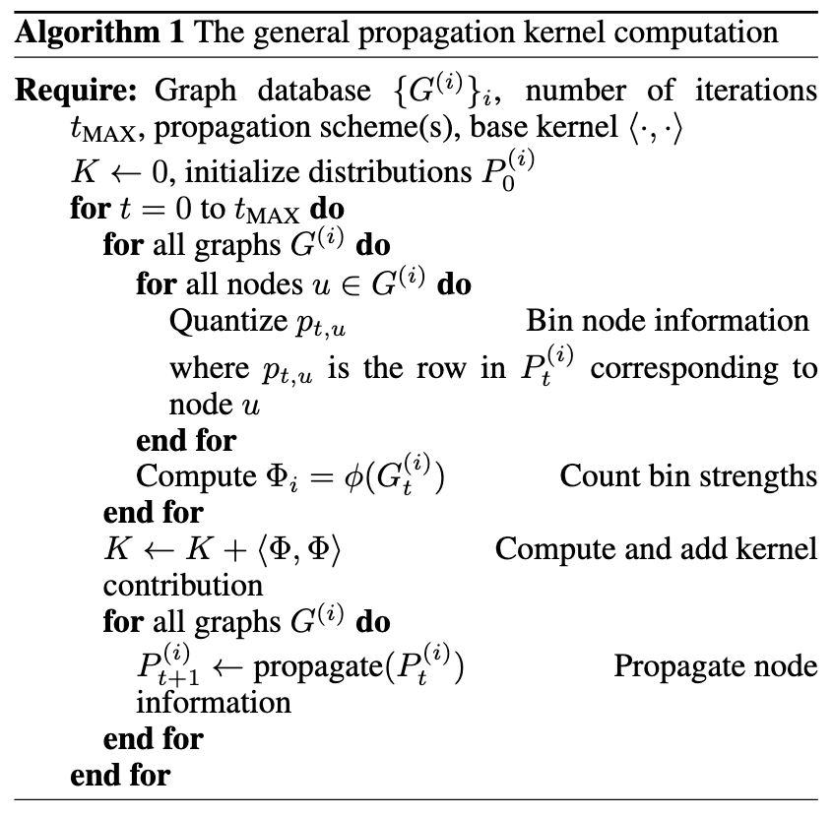
Propagation Kernel
Implementation - GraKeL library [Siglidis et al., 2020] to implement the propagation kernel
Vector consists of 3D relative coordinates and 3D relative velocities calculated with respect to a parent joint located closer to the center of the hip

Slide 9
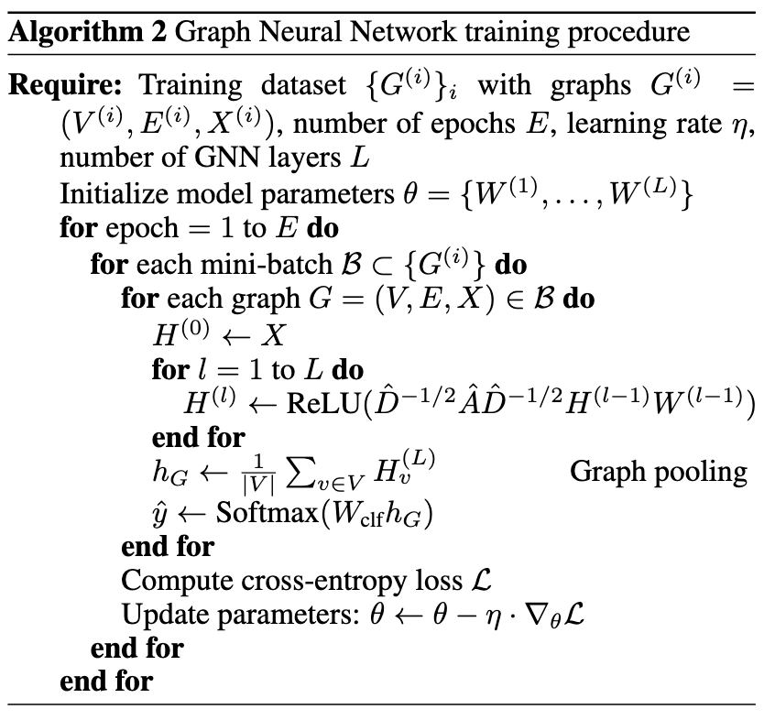
GNN
We used Pytorch Geometric library to implement the GNN model. Each graph was constructed with nodes representing skeleton joints over a 30-frame window, connected via anatomical and temporal (inter-frame) edges.
Node features were 5-dimensional vectors consisting of the 3D joint coordinates (x, y, z), a normalized temporal position within the sequence, and a normalized joint index. The temporal feature encodes the progression of the gesture, while the joint index helps the model distinguish different body parts.

Slide 10
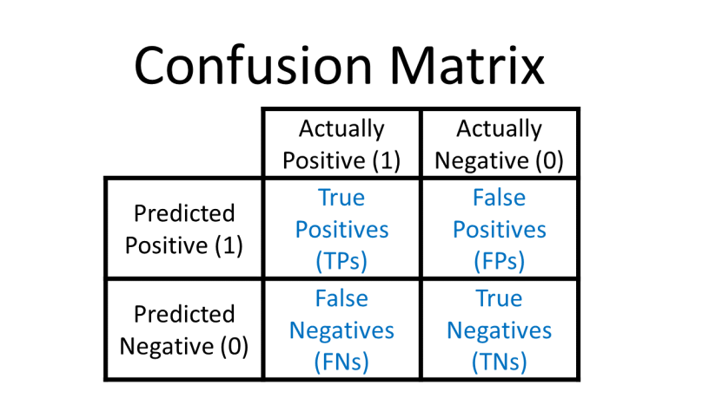
Evaluation metric
Confusion matrix for all 12 gestures of the MSRC-12 dataset
The matrix is of size 12×12

Slide 11
03
Results

Slide 12
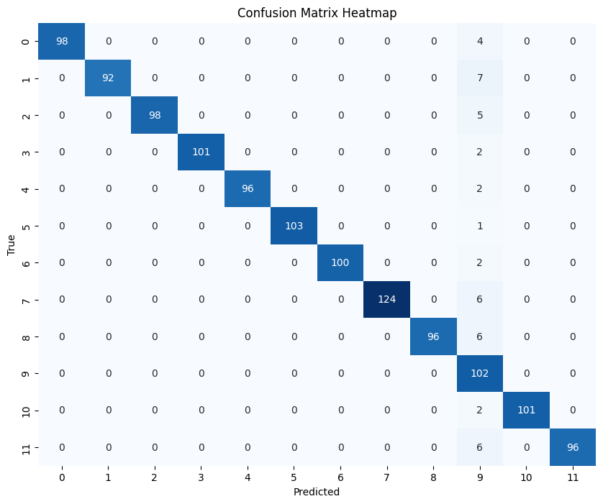
Propagation Kernel
Corresponds to the best performing model found after hyperparameter tuning
The model achieves an accuracy of 96.56%, showing near-perfect classification
The only significant confusion occurs with gesture 9, likely due to its visual similarity or higher intra-class variation

Slide 13
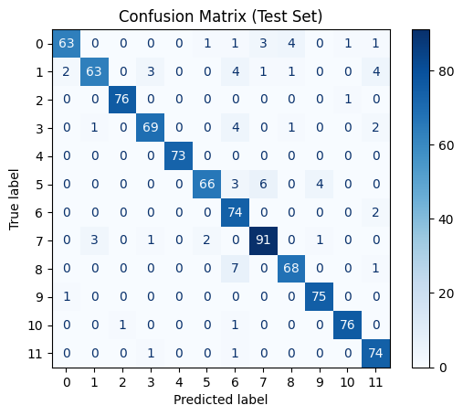
GNN
The best GNN configuration is obtained with depth d = 5 and
width w = 300, reaching a validation accuracy of 94.23%.
Overall, the matrix demonstrates that the GNN effectively leverages the input node features—comprising 3D coordinates, normalized temporal position, and joint identity—to build discriminative representations for gesture classification.

Slide 14
04
Discussion

Slide 15
Comparaison
The Propagation Kernel (PK) achieved slightly higher accuracy (96.56%) than the best GNN (94.23%), highlighting its robustness, simplicity, and effectiveness in capturing structural similarities. However, GNNs offer greater modeling flexibility and scalability through end-to-end learning, enabling them to capture more complex spatio-temporal patterns. While PKs are well-suited for small datasets with fixed structures, GNNs are better adapted to real-time or large-scale applications, though they require more careful tuning and computational resources.

Slide 16
Limits
Propagation Kernel:
Fixed propagation scheme → lacks adaptability
No end-to-end learning → can't optimize with data
Histogram binning → limits feature resolution on complex patterns
Graph Neural Network:
Requires careful tuning and more computation
Prone to overfitting on small datasets
Training is slower and less interpretable

Slide 17

Thanks!

Slide 18
Reference
[Borgwardt and Kriegel, 2005] Karsten M Borgwardt and Hans-Peter Kriegel. Shortest-path kernels on graphs. In Proceedings of the Fifth IEEE International Conference on Data Mining (ICDM), pages 74–81, 2005.
[Fothergill et al., 2012] Simon Fothergill, Helena Mentis, Pushmeet Kohli, and Sebastian Nowozin. Instructing people for training gestural interactive systems. In Proceedings of the SIGCHI conference on human factors in computing systems, pages 1737–1746, 2012.
[Neumann et al., 2016] Marion Neumann, Roman Garnett, Christian Bauckhage, and Kristian Kersting. Propagation kernels: efficient graph kernels from propagated information. Machine learning, 102:209–245, 2016.
[Shahroudy et al., 2016] Amir Shahroudy, Jun Liu, TianTsong Ng, and Gang Wang. Ntu rgb+d: A large scale dataset for 3d human activity analysis. In Proceedings of the IEEE Conference on Computer Vision and Pattern Recognition (CVPR), pages 1010–1019, 2016.
[Shervashidze et al., 2011] Nino Shervashidze, Pascal Schweitzer, Erik Jan van Leeuwen, Kurt Mehlhorn, and Karsten M Borgwardt. Weisfeiler-lehman graph kernels. In Journal of Machine Learning Research, volume 12, pages 2539–2561, 2011.
[Siglidis et al., 2020] Giannis Siglidis, Giannis Nikolentzos, Stratis Limnios, Christos Giatsidis, Konstantinos Skianis, and Michalis Vazirgiannis. Grakel: A graph kernel library in python. Journal of Machine Learning Research, 21(54):1–5, 2020.
[Veličković et al., 2018] Petar Veličković, Guillem Cucurull, Arantxa Casanova, Adriana Romero, Pietro Lio, and Yoshua Bengio. Graph attention networks. In International Conference on Learning Representations (ICLR), 2018.
[Yan et al., 2018] Sijie Yan, Yuanjun Xiong, and Dahua Lin. Spatial temporal graph convolutional networks for skeleton-based action recognition. In Proceedings of the AAAI Conference on Artificial Intelligence, volume 32, 2018

